Slide 1

Compliance | Control Monitoring | Automation
drut.
turn your control program into a business enabler

Slide 2
What the world is telling us
The GRC (Governance, Risk & Compliance) landscape is transforming from being a ‘cost centre’ to a strategic driver of trust and growth.
Organizations now manage multiple frameworks simultaneously and admit that manual, siloed control, and compliance processes no longer work.
Automation, AI, and continuous monitoring are redefining GRC — embedding compliance earlier in the business lifecycle (“Shift‑Left”) to reduce risk and accelerate assurance.
Regulatory change, cyber threats, ESG, and third‑party risk are all intensifying the demand for intelligent, connected control ecosystems.
drut.

Slide 3
Why you need a next-gen control & compliance Platform
Manual testing, spreadsheets, and ad‑hoc evidence collection are inefficient, error‑prone, and slow.
Traditional systems do not adapt to regulatory change or provide real‑time assurance.
Organisations face fines, control failures, reputational damage, and higher costs — all while audit and compliance teams struggle to keep pace.
A modern control and compliance platform is essential for agility and resilience.
drut.

Slide 4
Current Pain Areas and Challenges
Manual control testing and data collection → High effort, error risk
Non-standardized control logic → Inconsistent assurance quality
Lack of integration across tools → Redundant effort, poor visibility
Delayed reporting → Reactive compliance posture
Limited analytics → No predictive insights for assurance planning
BENEFITS WE LOOK FOR
Reduced Cost & Effort: Cut manual testing and evidence gathering time.
Improved Control Effectiveness: Detect issues earlier with automation.
Leadership Visibility: Deliver real‑time insights and faster decisions.
Agility: Adapt quickly to new frameworks and regulatory changes.
Strategic Advantage: Turn compliance into a differentiator that builds trust
drut.

Slide 5
Why Drut. – The Assurance Engine
drut. is an no-code, automation‑first GRC & control assurance platform that transforms risk management into a proactive, data‑driven function.
Automates control workflows from policy to dashboards.
Integrates with ERP, HR, technology, cyber and finance systems - 50+ ready connectors
Provides a robust controls library aligned to ISO, NIST, PCI DSS, and more.
Enables real‑time dashboards and analytics for continuous monitoring.
Automates evidence collection via OCR across Word, Excel, PDF, and images.
Delivers audit‑ready documentation (road map) with full traceability and audit trail generation
Scales globally with multi‑jurisdiction compliance flexibility and large datasets
AI-driven anomaly detection and exception analytics (road map)
ship
drut.

Slide 6
Quantified Value and Strategic Outcomes
Continuous control monitoring readiness
  Continuous audit readiness (road map)
60–70% reduction in compliance effort cost
Manual effort in control execution ↓ 70–80%
Control accuracy improved to >95%
Zero manual dependency for automated controls
80% faster evidence retrieval and reporting
  Evidence retrieval time near real-time (road map)
Improved audit confidence and standardized taxonomy (structured classification system) (road map)
Real-time assurance visibility for lead
Role-based dashboards for CXOs and compliance leads
Reporting turnaround reduced to <48 hours
drut.

Slide 7



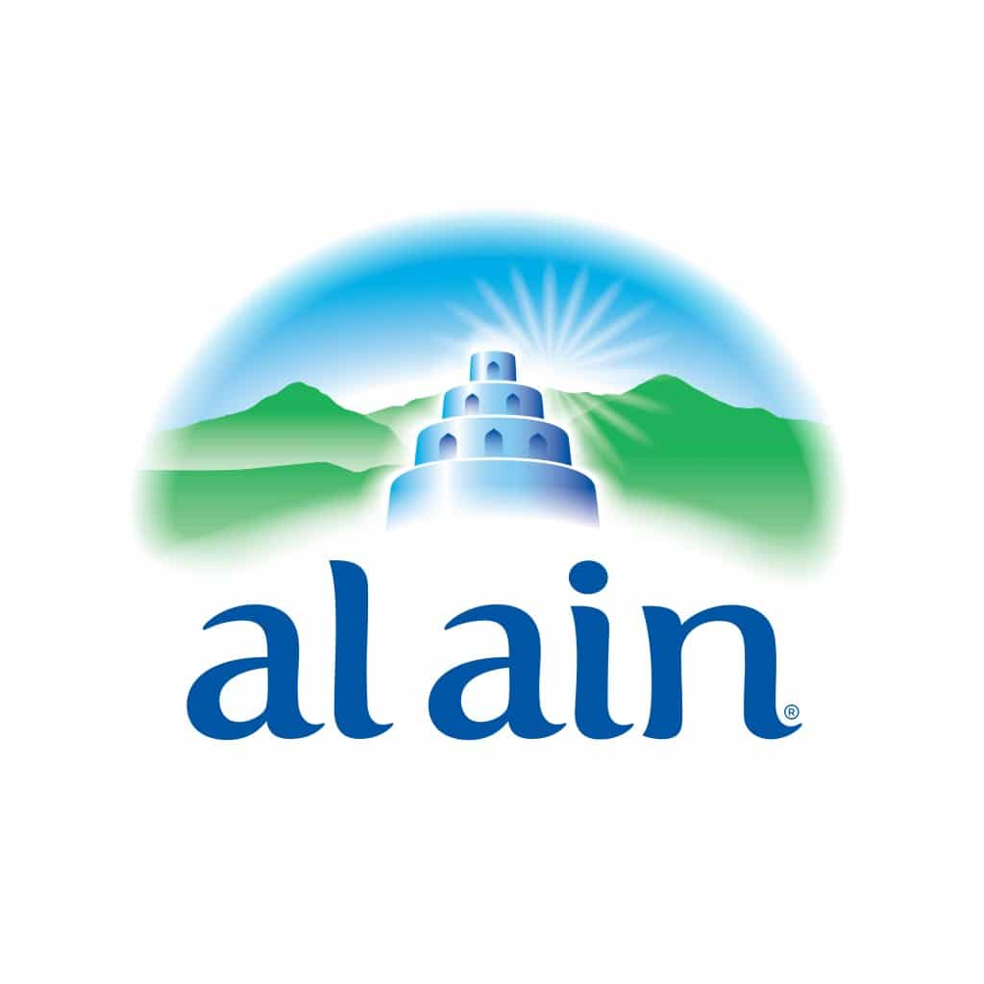




















Implementations
drut.

Slide 8
The Way Forward
Automation and AI are transforming compliance and assurance functions globally. drut. enables organisation's to move from reactive reporting to continuous assurance - reducing operational drag, improving transparency, and creating measurable business value. With drut., control and compliance become catalysts for smarter, faster, and more trusted operations.
Next Steps
Schedule a live demo and mapping session
Identify a pilot use‑case: access governance, vendor risk, or control testing.
Measure improvement in control performance and efficiency.
Expand adoption across functions and frameworks to scale enterprise‑wide assurance
drut.

Slide 9

Nirma Varma
Partner
Head of Technology Risk & Cyber Security
nirma.varma@drut.com
Preeti Kothari
Director
Technology Risk & Cyber Security
preeti.kothari@drut.com
Sanjiv Vanker
Digital Account Executive
sanjiv.vanker@drut.com
CONNECT WITH US
drut.
drut.
drut.
drut.
drut.
drut.
drut.
drut.

